Slide 1
IEEE1666 SystemC TLM2.0
Coulpling gem5 with
Dipl.-Ing. Matthias Jung
Microelectronic Systems Design Research Group
Freitag, 12. Juni 2015

Slide 2
Virtual Prototypes In Industry
High-speed functional software models of physical hardware
Visibility and controllability over the entire system
Powerful debugging and analysis tools
Reuse of components for future projects
Fast Design space exploration (for HW engineers)
Easy to exchange, worldwide
Concurrent HW and SW development:
Earlier TTM
Software
development
Higher Quality
Effort
Hardware
development
Testing /
Integration
Product support
and maintenance
Product support & maintenance
Time-to-Market

Slide 3

SystemC IEEE 1666
Modeling language for HW and SW components
Extends C++ to an event-driven simulation kernel
Different levels of accuracy
IEEE Standard, Maintained by Accellera
10-100x Faster than CA VHDL/Verilog Simulation
→However, standard CA SystemC is not fast enough to
boot, an operating system.

Slide 4
Transaction Level Modeling
CA
SystemC
TLM
CLK
Pin Accurate
Function Call
CA
SystemC
TLM
CLK
Simulate every event!!
100-10,000 X faster simulation!
Source: Doulos Ldt. www.doulos.com

Slide 5
Generic Payload
Generic payload object
Command
Address
Data
Byte Enables
Response Status
Target
(MEM)
Extensions
Target
Socket
Payload reference
Initiator
(CPU)
Interconnect
(BUS)
&
Initiator
Socket
Initiator
Socket
Target
Socket
Target
(I/O)
Initiator
Socket
Notes:
SystemC:
Erweiterung für C++
Um HW und SW im Zusammenspiel zu simulieren
IEEE Standard
OSCI: Open SystemC Initiative
TLM2.0
Transaction Level Modeling
Erweiterung für SystemC um effektiv Kommunikation zu Simuliern
Focus liegt hierbei auf der Funktionalität nicht auf der genauen Implementierung
Transactions: Payload
Command: read or write
Adress: quell / zieladdresse
Daten
Nur eine Referenz wird übertragen → Simulation wird beschleunigt!
Initiator: Master! prozessor
Target: Slave! mempory

Slide 6
TLM Coding Styles and Mechanisms
TLM Use Cases
SW Application Development
SW Performance
Analysis
Architecture
Analysis
Hardware Verification
TLM 2.0 Coding Style (Just Guidelines)
nb_transport
Loosely-timed
Multi-phase, non-blocking API
Single-phase, blocking API
Approximately -timed
Debug_transport, b_transport
TLM Mechanisms (Definitive API for enabling Interoperability)
Blocking transport
DMI
Quantum
Sockets
Generic
payload
Extensions
Phases
Non-blocking transport
Source: Doulos Ldt. www.doulos.com

Slide 7
Tool Vendors for TLM2.0 VP
TLM is widely used in Industry:
The market of virtual platform tools:
Synopsys - Platform Architect
Cadence - Virtual System Platform
Mentor Graphics - Vista Virtual prototyping
Imperas – OpenVP
Virtual Platform Core Models:
ARM (Fastmodels):
  only LT models based on JIT, non-free
Carbon Design Systems:
  Cycle Accurate (CA) Models in TLM Wrapper, non-free
Imperas / OVP:
  only LT, Free
→ An accurate, free available and changeable core model is needed

Slide 8
Couple gem5 with SystemC
Since June 2014 gem5 supports a SystemC coupling. However, no TLM
Gem5 is build as a C++ library
It is hooked onto SystemC's event loop.
The hosting is achieved by replacing 'simulate' with a SystemC object, which implements an event loop using the SystemC scheduler mechanisms.
Currently only one gem5 instance can be in a SystemC simulation.
Logic
Logic
Events
Time
Events
Time

Slide 9
Transaction Models in gem5
Timing
  The most detailed access: queuing delay + resource contention
  Similar to the TLM nb_transport interface.
Atomic
  Accesses are a faster than detailed access
  Used for fast forwarding and warming up caches
  Similar to the TLM b_transport interface
  Not good for performance simulation
Functional
  Similar to transport_debug
  e.g. loading binaries, avoiding deadlocks in multi-level cache coherent networks

Slide 10
Coupling gem5 with SystemC-TLM
Gem5 World
Transactor
(sc_port.{cc|hh})
TLM World
GSPort::recvFunctional(PacketPtr packet)
port->transport_dbg(payload);
GSPort::recvAtomic(PacketPtr packet)
port->b_transport(payload, delay);
GSPort::recvTimingReq(PacketPtr packet)
port->nb_transport_fw(pl, ph, dly);
Transactor:
Gem5-Packet to TLM-Payload converter
Uses gem5 event queue as TLM-Payload-Event queue
Implements fully TLM2.0 compliant functionality

Slide 11
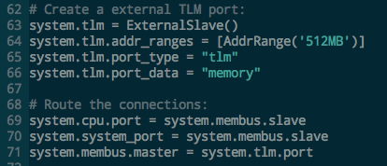
Setting up an external Port in gem5
CPU
DRAM
UART
PL011
...
X-Bar
ExternalPort
Python Config:

Slide 12
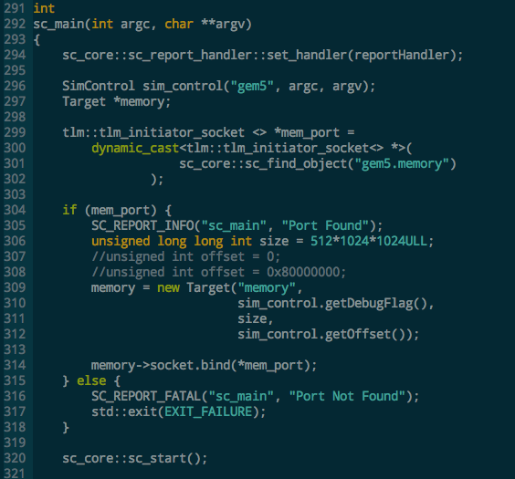
Picking Ext. Port up in SystemC World
Instantiate gem5 as sc_module
Find external Port with sc_find_object
Instantiate a TLM target
Bind the target’s port with the external port of gem5

Slide 13
Simple Traffic Generator Example

Slide 14
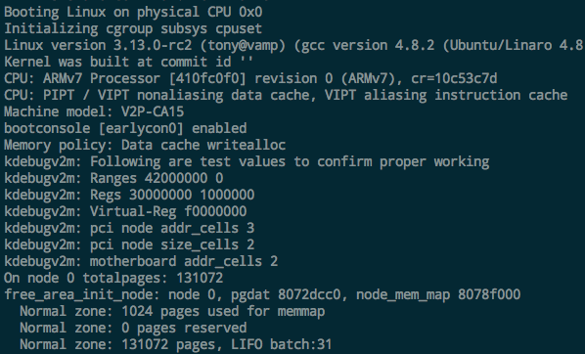
Full System Linux Boot Example

Slide 15
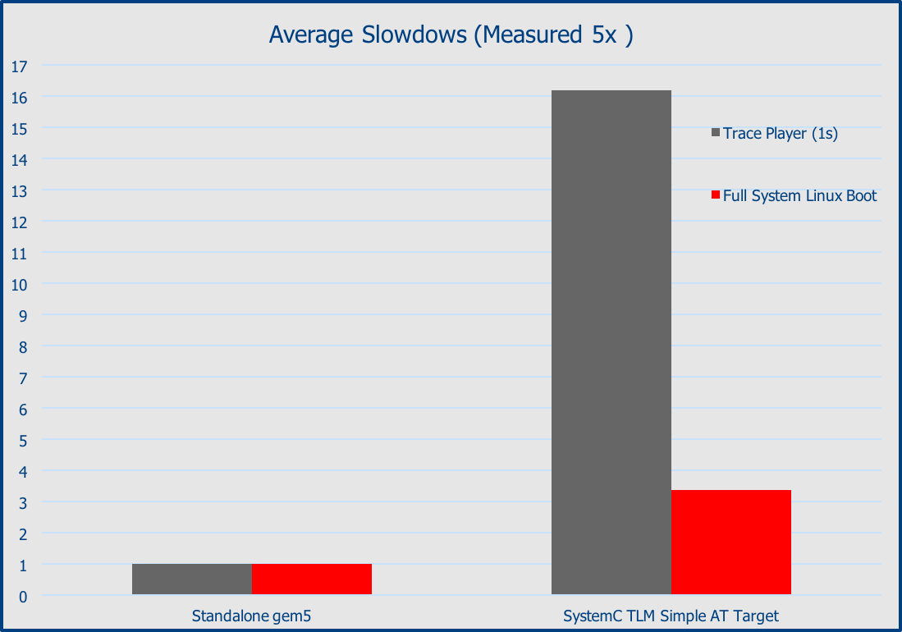
Results Slowdown
~16x
~3.5x

Slide 16
Outlook
Use a TLM memory manager to be fully TLM compliant
Improve speed (e.g by implementing a TLM memory manager)
Fix some bugs regarding Atomic Access and Retry
Connect gem5 to DRAMSys (inhouse DRAM TLM Simulator)
Use gem5 in Synopsys Platform Architect
Currently on the gem5 review board:
#2753
http://reviews.gem5.org/r/2753/
Please test and give feedback

